Slide 1
Finding Area Under the Normal Curve
Chapter 5 Part 2

Slide 2
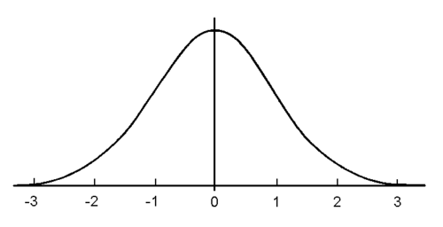
Z-scores
Recall the Normal Curve Model
Each tick mark (z-score) is a distance of one Standard Deviation
Values that are $−2<z<2$ are considered typical
Values that are $z<−3$ and $z>3$ are considered unusual
The farther from the center, the more unusual the value becomes
z-scores

Slide 3
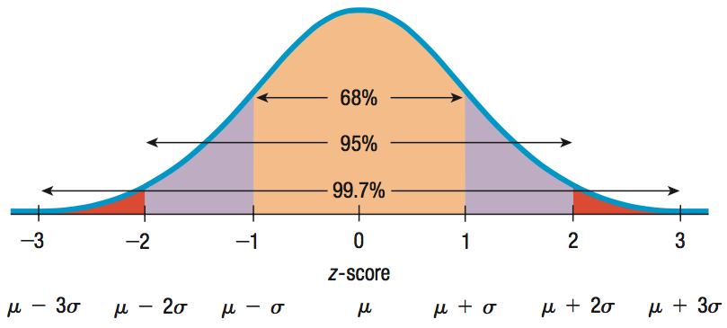
It turns out that there is a specific amount of area under the curve bounded between these z-scores and we can use this area to predict the probability of its occurrence!
For data that are unimodal and symmetric, about 68% fall within 1 SD of the mean, 95% fall within 2 SDs of the mean, and 99.7% fall within 3 SDs of the mean. This is the 68-95-99.7% Rule.

Slide 4

Find Area
The 68-95-99.7% Rule is an approximation. We can get better accuracy using our calculator.
Your calculator uses
normalcdf( lower z , upper z)
format.
Follow the keystrokes on the left to calculate the area under the curve between -1<z<1.
Normalcdf(-1,1) = 0.6826894809
About 68%
2nd VARS
#2 normalcdf(
Depending on your calculator
-1,1) ENTER
OR
Lower: -1
Upper: 1
$$μ=0$$
$$σ=1$$
Paste
ENTER

Slide 5
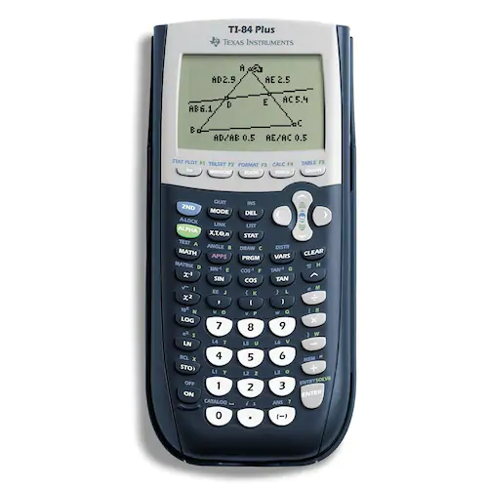
Did you get a syntax error?
Make sure you are using the little negative sign on the bottom right of the calculator and not the subtraction sign in order to enter -1.
Subtraction sign
Negative sign

Slide 6

Find Area
Try another!
Follow the keystrokes on the left to calculate the area under the curve between -3.5<z<2.
Normalcdf(-3.5,2) = 0.97701726469
About 97.7%
2nd VARS
#2 normalcdf(
Depending on your calculator
-3.5,2) ENTER
OR
Lower: -3.5
Upper: 2
$$μ=0$$
$$σ=1$$
Paste
ENTER

Slide 7

Find Area
Try another!
Calculate the area under the curve z>1.
When it is not bounded on the right, we use 100.
Normalcdf(1,100) = 0.1586552596
About 15.9%
2nd VARS
#2 normalcdf(
Depending on your calculator
1,100) ENTER
OR
Lower: 1
Upper: 100
$$μ=0$$
$$σ=1$$
Paste
ENTER

Slide 8
Find Area
Try another!
Calculate the area under the curve z<2.
When it is not bounded on the left, we use -100.
Normalcdf(-100,2) = 0.977249938
About 97.7%
2nd VARS
#2 normalcdf(
Depending on your calculator
100,2) ENTER
OR
Lower: -100
Upper: 2
$$μ=0$$
$$σ=1$$
Paste
ENTER

Slide 9

Know Area
What if we know the area, but don’t know the z-score?
Your calculator uses
invnorm( area on the left)
format.
Find z-score for bottom 5%.
invnorm(0.05) = -1.644853626 = z
2nd VARS
#3 invnorm(
Depending on your calculator
0.05) ENTER
OR
Area: 0.05
$$μ=0$$
$$σ=1$$
Paste
ENTER
5%

Slide 10

Know Area
Try another!
Find z-score for upper 10%.
This means that if the upper area is 10% then the lower (left) area is 90%.
invnorm(0.90) = 1.281551567 = z
2nd VARS
#3 invnorm(
Depending on your calculator
0.90) ENTER
OR
Area: 0.90
$$μ=0$$
$$σ=1$$
Paste
ENTER
90%
10%

Slide 11
Summary
Find Area
Know Area
normalcdf( lower z , upper z)
invnorm( area on the left)
Recall $z=\frac{data−center}{SD}$

